Slide 1
Electricity prices prediction
proj_220066_team_1

Slide 2
1. Introduction
Briefly introduce the concept of electricity price prediction.
Highlight the importance of accurate price predictions in the energy sector.

Slide 3
2. Futures
Discuss the methods and technologies used in electricity price prediction.
Explain the role of historical data, machine learning, and statistical models.

Slide 4
Abstract
Abstract Electricity is central to many parts of life in modern societies and will become even more so as its role in transport and heating expands through technologies such as electric vehicles and heat pumps. Power generation is currently the largest source of carbon dioxide (CO2) emissions globally, but it is also the sector that is leading the transition to net zero emissions through the rapid ramping up of renewables such as solar and wind. At the same time, the current global energy crisis has placed electricity security and affordability high on the political agenda in many countries. The International Energy Agency’s Electricity Market Report 2023 offers a deep analysis of recent policies, trends and market developments. It also provides forecasts through 2025 for electricity demand, supply and CO2 emissions – with a detailed study of the evolving generation mix. This year’s report contains a comprehensive analysis of developments in Europe, which faced a variety of energy crises in 2022. The Asia Pacific region also receives special focus, with its fast-growing electricity demand and accelerating clean energy deployment. The IEA’s Electricity Market Report has been published since 2020. Its relevance goes beyond energy and climate issues, since electricity supply impacts economies, regional development, the budgets of businesses and households, and many other areas. It is indispensable reading for anyone interested in the multifaceted importance of energy in our economies and societies today.

Slide 5
EXECUTIVE SUMMARY
World electricity demand remained resilient in 2022 amid the global energy crisis triggered by Russia’s invasion of Ukraine. Demand rose by almost 2% compared with the 2.4% average growth rate seen over the period 2015-2019. The electrification of the transport and heating sectors continued to accelerate globally, with record numbers of electric vehicles and heat pumps sold in 2022 contributing to growth. Nevertheless, economies around the world, in the midst of recovering from the impacts of Covid-19, were battered by record-high energy prices. Soaring prices for energy commodities, including natural gas and coal, sharply escalated power generation costs and contributed to a rapid rise in inflation. Economic slowdowns and high electricity prices stifled electricity demand growth in most regions around the world. Electricity consumption in the European Union recorded a sharp 3.5% decline year-on-year (y-o-y) in 2022 as the region was particularly hard hit by high energy prices, which led to significant demand destruction among industrial consumers. Exceptionally mild winter added further downward pressure on electricity consumption. This was the EU’s second largest percentage decrease in electricity demand since the global financial crisis in 2009 – with the largest being the exceptional contraction due to the Covid-19 shock in 2020.

Slide 6
GLOBAL OVERVIEW
energy crisis sparked by the Russian Federation’s (hereafter “Russia”) invasion of Ukraine has been characterised by record-high commodity prices, weaker economic growth and high inflation. Higher fuel prices increased the cost of electricity generation around the world, putting downward pressure on consumption in many regions. Despite the worsening crisis, global electricity demand remained relatively resilient, growing by almost 2% in 2022.By 2025, for the first time in history, Asia will account for half of the world’s electricity consumption and one-third of global electricity will be consumed in China. Over the outlook period, global electricity demand is set to grow at an accelerated pace, by an annualised 3%, as electricity consumption increases in emerging markets and developing economies (EMDEs), led by the People’s Republic of China (hereafter “China”), India and Southeast Asia. As the energy crisis abates, global electricity demand growth is set to rise from 2.6% in 2023 to an average 3.2% in 2024-2025. This stronger growth is well above the pre-pandemic rate of 2.4% observed in the 2015-2019 period. Indeed, by 2025 demand will increase by 2 500 TWh from 2022 levels, which means that over the next three years the electricity consumption added each year is roughly equivalent to that of the United Kingdom and Germany combined. More than half of the increase will come from China. The remaining growth will largely take place in India and Southeast Asia.

Slide 7
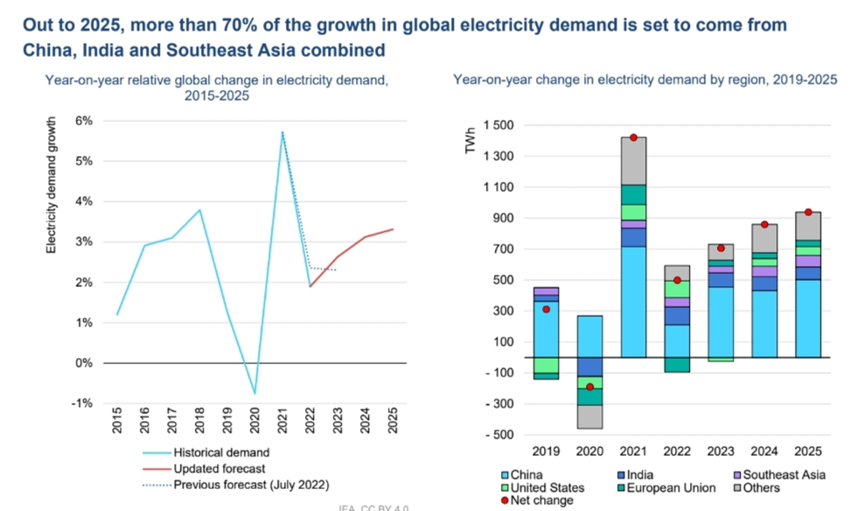

Slide 8
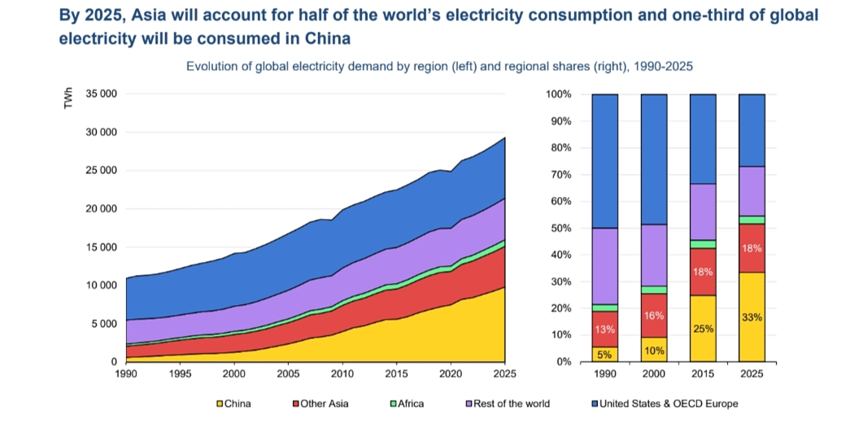

Slide 9
3. Uses
Describe the various applications of electricity price prediction:
Energy market trading and investment decisions.
Energy consumption optimization for consumers.
Grid management and capacity planning for utilities.

Slide 10
Loading and Preprocessing the Dataset: Electricity price prediction begins with the acquisition and preparation of relevant data. The process often involves the following steps: -Data Collection:
Gather historical electricity price data from various sources, such as energy market records, sensors, or historical market prices.

Slide 11
Data Cleaning:Address data quality issues, including handling missing values, outliers, and inconsistencies in the dataset. Exploratory Data Analysis (EDA): Conduct EDA to gain insights into the dataset's characteristics, understand trends, and identify potential feature variables.
Feature Selection:
Choose the most relevant features (predictors) for the prediction task. Features can include historical prices, time of day, day of the week, holidays, and external factors like weather conditions.

Slide 12
Feature Engineering:
Create new features that capture meaningful patterns in the data. Examples include rolling averages, lag features, or indicators for seasonality. Data Transformation:
: Prepare the data for modeling, which may involve creating sequences for time series analysis or utilizing lag features for time-dependent patterns.

Slide 13
Performing Advanced Activities: Model Selection:Choose an appropriate prediction model based on the specific requirements of the project. Common models include time series forecasting models (e.g., ARIMA, LSTM), regression models, or machine learning algorithms. Model Training:
Train the selected model using the training dataset. The model learns patterns and relationships from historical data.

Slide 14
Evaluation:
Assess the model's performance using suitable metrics, typically mean squared error (MSE), root mean squared error (RMSE), or others, on the validation set. Adjust model parameters or features as needed. Testing:
Test the trained model on the separate test set to evaluate its ability to generalize to unseen data. This helps ensure the model's reliability

